Slide 1

Coursera
Course 8 Week 2:
Basic Visualization Tools
Nov 14, 2023
From your friends in Group 2:
Barb, Olena, Ali, Dona, Sushmitha, Hossna
*After the break today, Group 3 will cover Specialized Visualization Tools
Notes:
Links for today:
This presentation: Basic Visualization Tools-Group2-Nov14
Area Plot exercise: Nov14-Area_Plot_presentation.ipynb
Histogram exercise: https://colab.research.google.com/drive/1LEFtJ2Hi5Jb5U6JaZpteGFM5PZbsb0kA?authuser=0#scrollTo=1cYSmaCeDq_x
Bar chart exercise: Cluedo-Bar Charts exercise.ipynb
Jeopardy game: https://jeopardylabs.com/play/nov14_g2-basic-matplotlib-visualization-tools

Slide 2
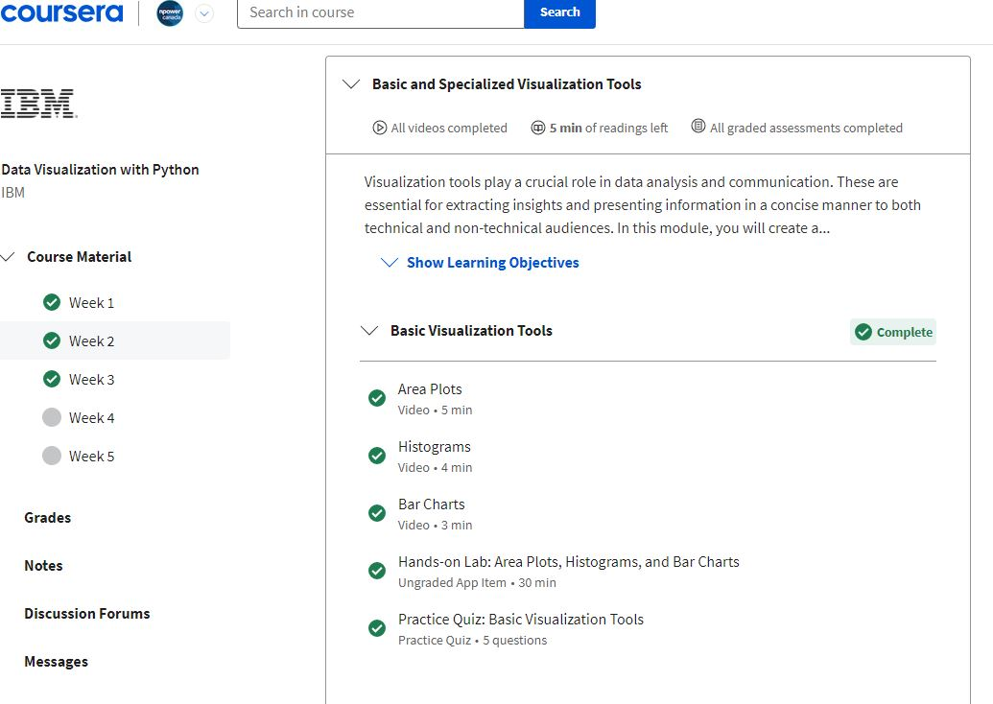

Slide 3
Basic Visualization Tools Content
By the end of this week, you will be able to:
Explore an area plot with an illustration and create it using Matplotlib
Define a histogram with an illustration and create it using Matplotlib
Describe a bar chart with an illustration and create it using Matplotlib
Discover a pie chart with an illustration and create it using Matplotlib
Describe a box plot with an illustration and create it using Matplotlib
Lesson 1: Basic Visualization Tools
Area Plots
Histograms
Bar Charts
Hands-on Lab: Area Plots, Histograms, and Bar Charts
Practice Quiz: Basic Visualization Tools
Upcoming…
Lesson 2: Specialized Visualization Tools

Slide 4

Agenda
9:30 - 10am:
Overview Theory and Exercises for:
Area Plots (10 mins total)
Histograms (10 mins)
Bar Charts (10 mins)
10 - 11am:
GAME TIME
11 - 11:30am: BREAK
Upcoming…
Lesson 2: Specialized Visualization Tools
Here’s our plan for today…
from now until the break

Slide 5
Questions?
with Hossna & Ali
Next up: Area Plots
5 mins Theory
5 mins Exercise

Slide 6
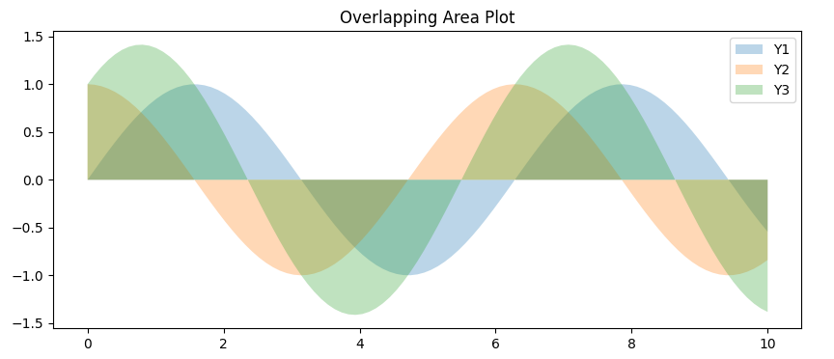
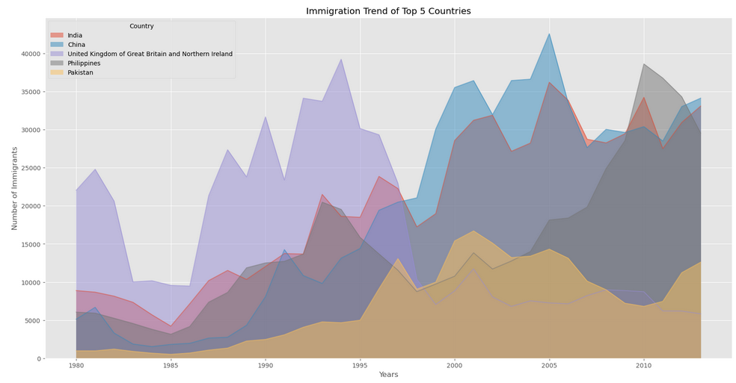
Area Plots
5 mins
Here’s what you need to know:
Displays the magnitude and proportion of multiple variables over a continuous axis typically representing time or another ordered dimension
It's similar to a line plot, but with the area below the line filled with color to emphasize the cumulative magnitude of the variables
This kind of graph is commonly used when trying to compare two or more quantities

Slide 7
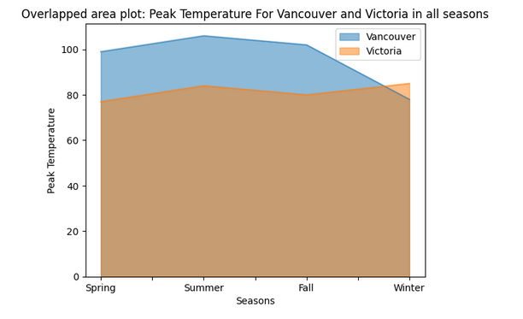
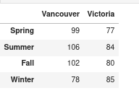
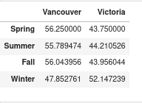
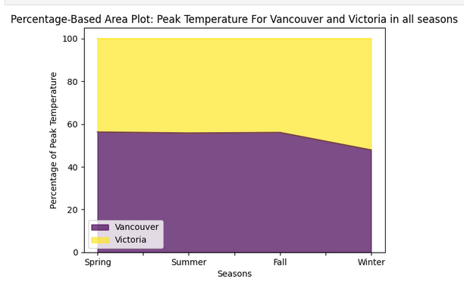
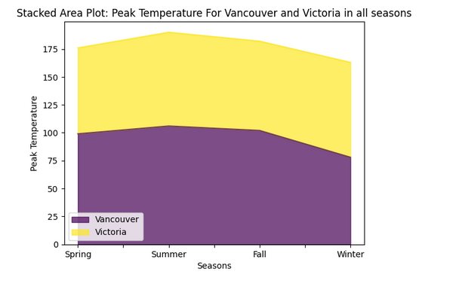
5 mins
Here’s how to do it… let’s practice!
https://jupyter.org/try-jupyter/lab/index.html
Notes:
Link to notebook: https://drive.google.com/file/d/1QPgrDLxtYKCMz0VxQE5h-2N-npfyeDmR/view?usp=sharing

Slide 8
Questions?
with Barb and Dona
Next up: Histogram Charts
5 mins Theory
5 mins Exercise

Slide 9
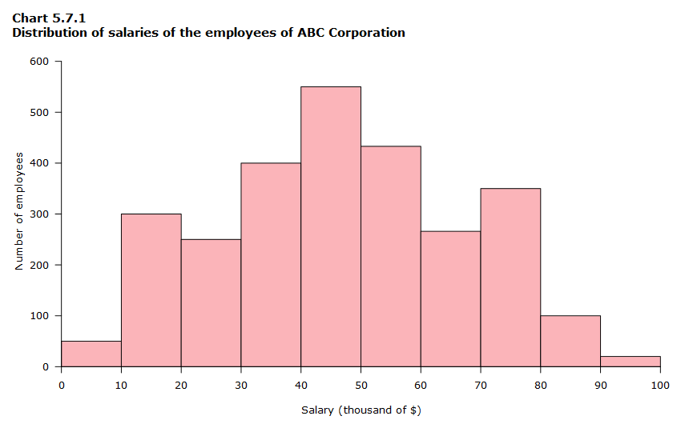
Histogram Plots
5 mins
"A histogram is a graphical representation of the distribution of a dataset”
Key components of a histogram plot:
Bins: The range of values in the dataset is divided into intervals or bins.
Frequency/Count: The height of each bar corresponds to the frequency or count of data points within the respective bin.
X-Axis: The horizontal axis represents the variable being measured or observed.
Y-Axis: The vertical axis represents the frequency or count of data points within each bin.
Insights include:
shape, spread and central tendencies of a continuous numerical dataset

Slide 10
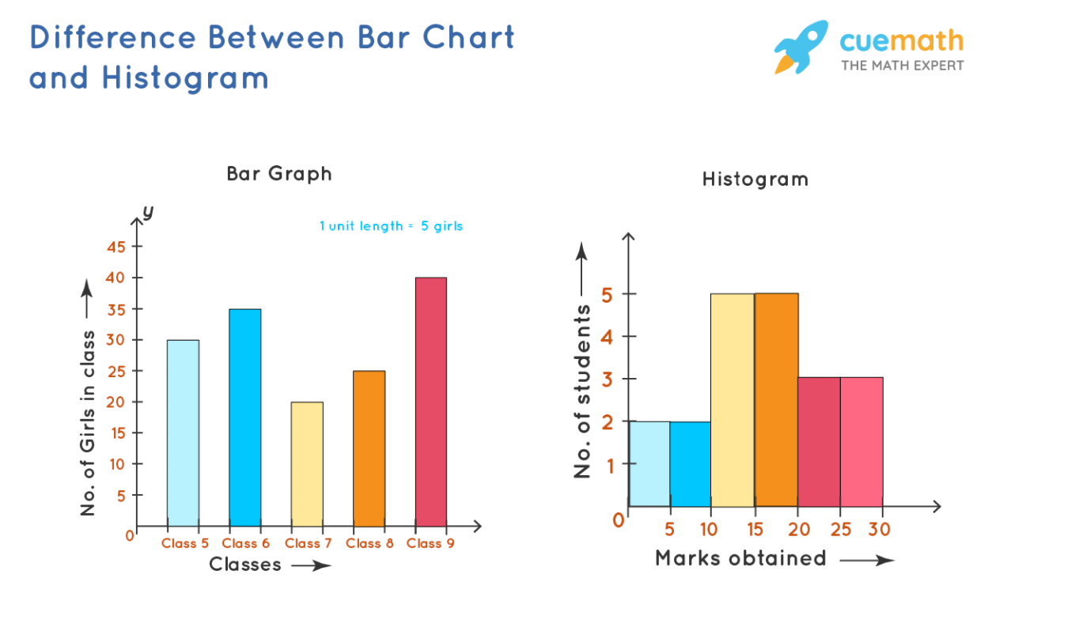
Histograms vs. Bar Charts
5 mins
Histogram:
Represents numerical data.
Data is arranged in the order of range
The X-axis should represent only continuous data that is in terms of numbers
Purpose of Histograms:
"Highlighting outliers and anomalies."
"Understanding the central tendency and spread of a dataset."
"Identifying patterns and trends in data."

Slide 11
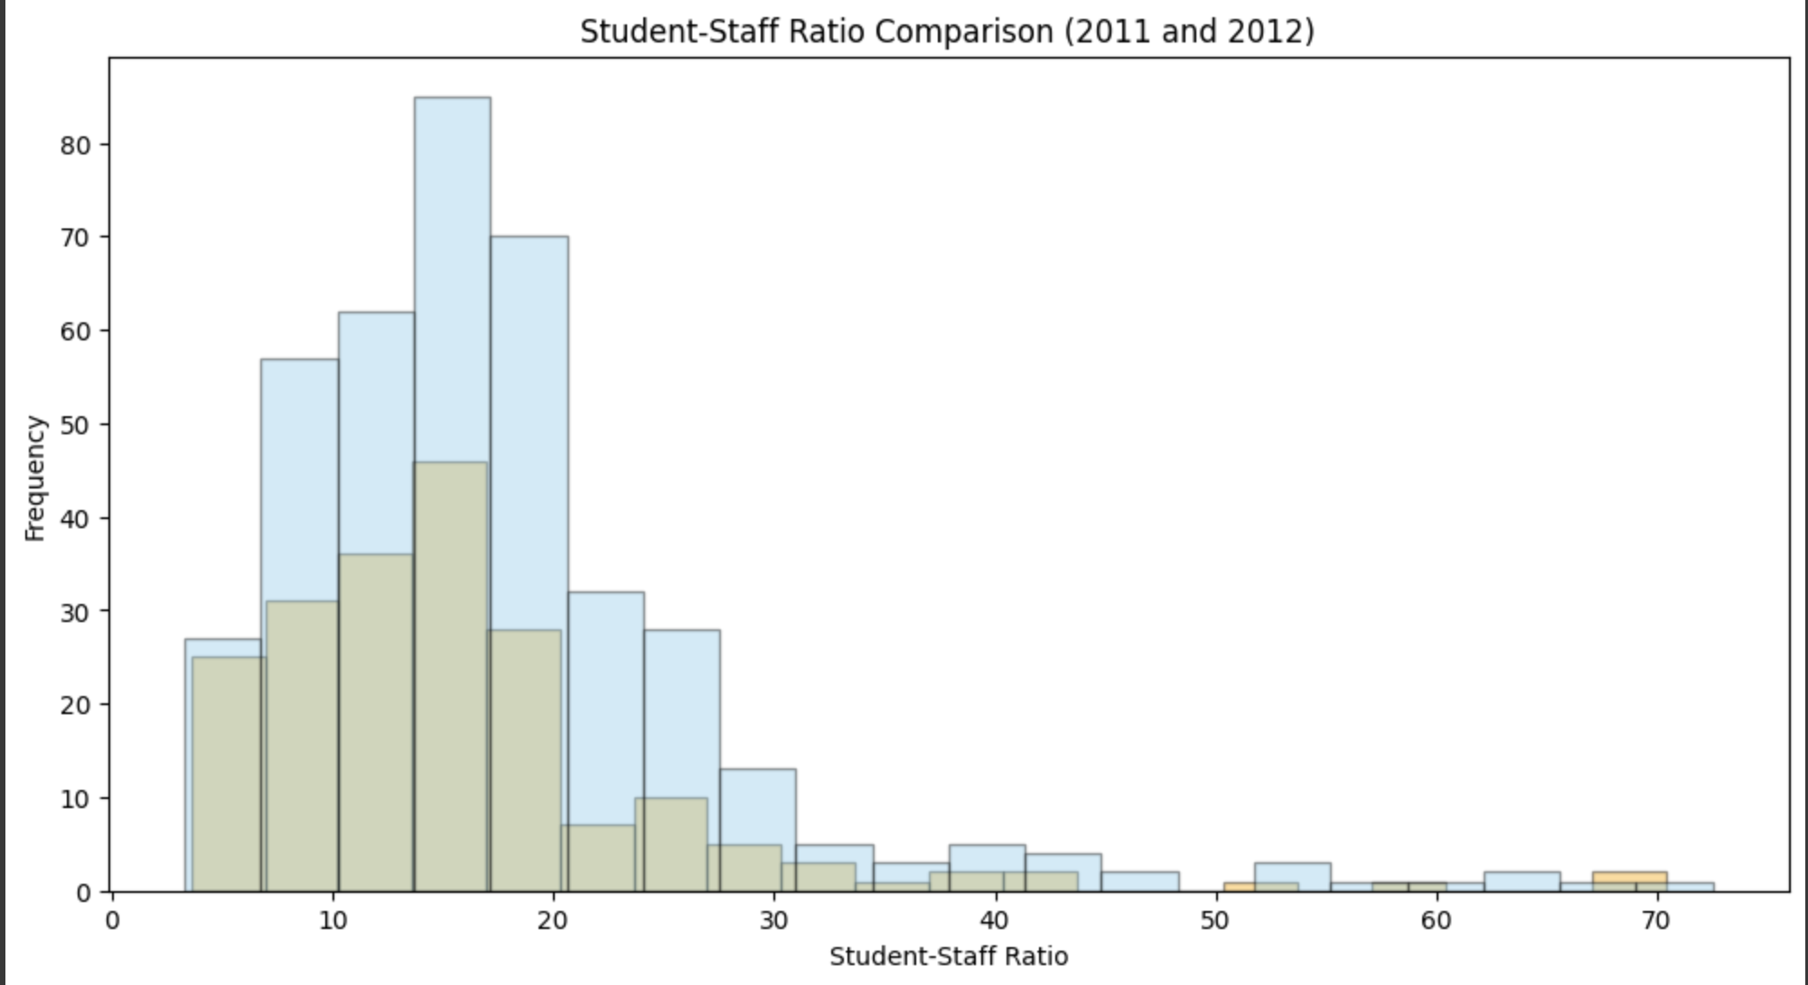
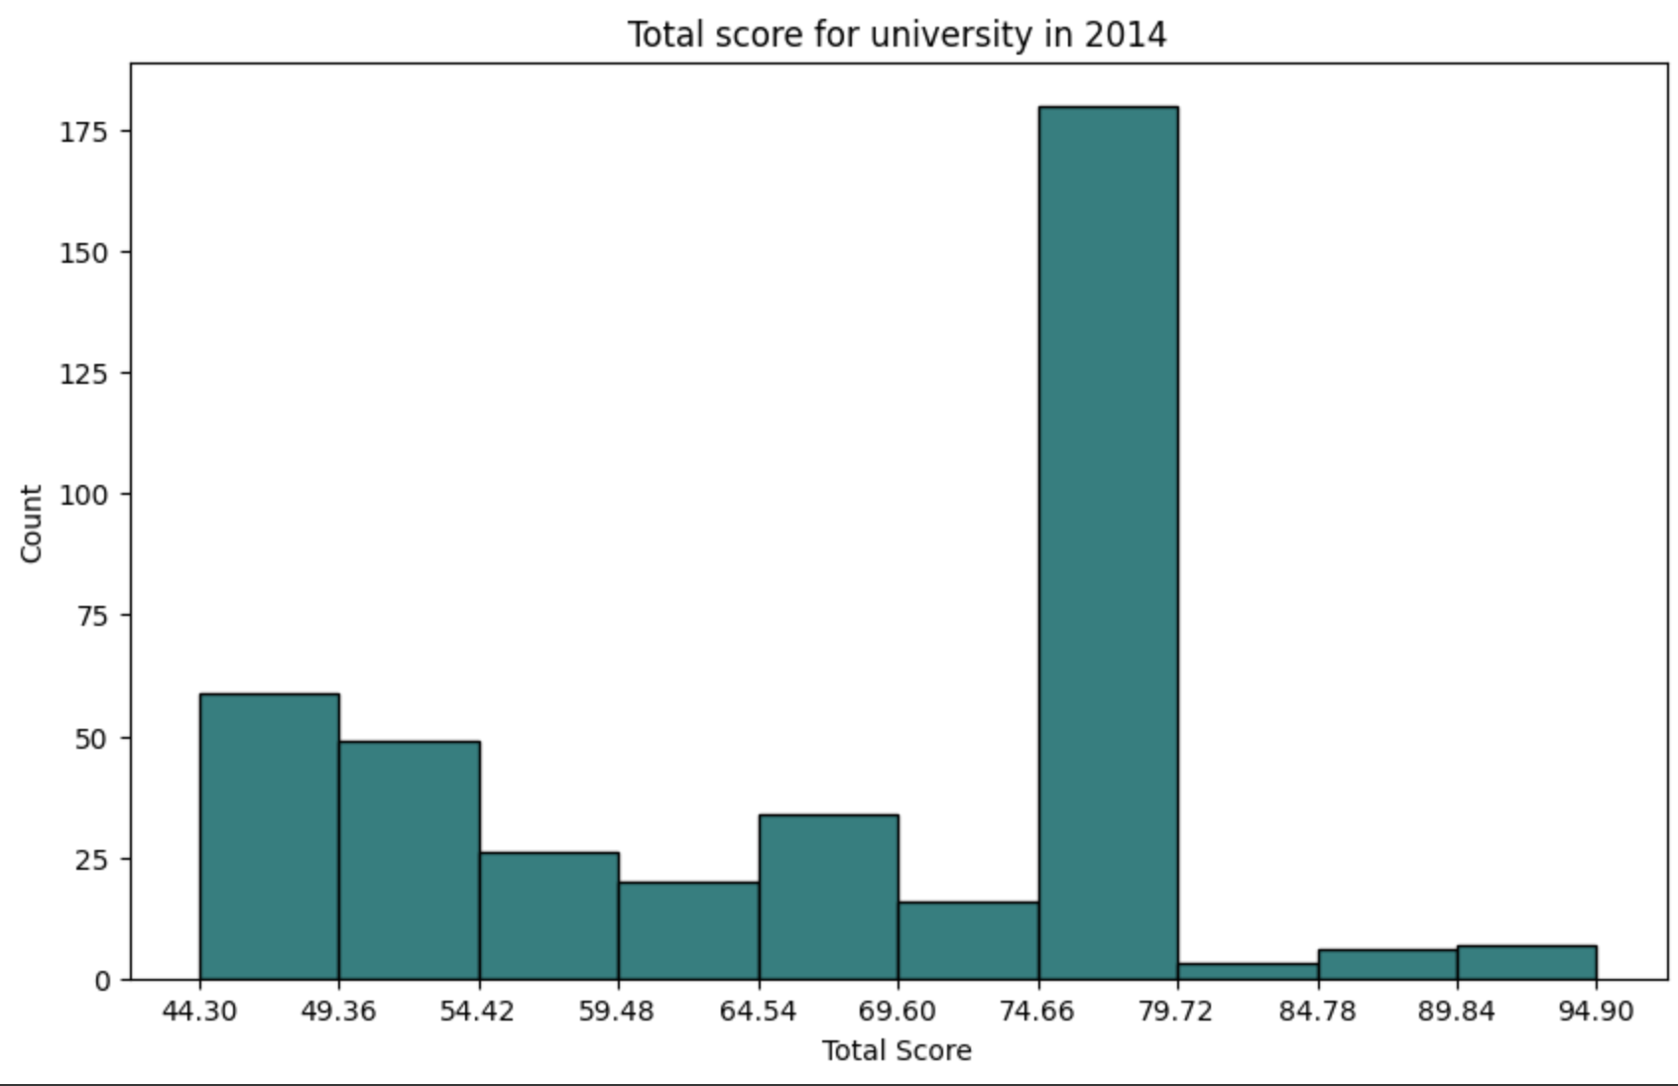
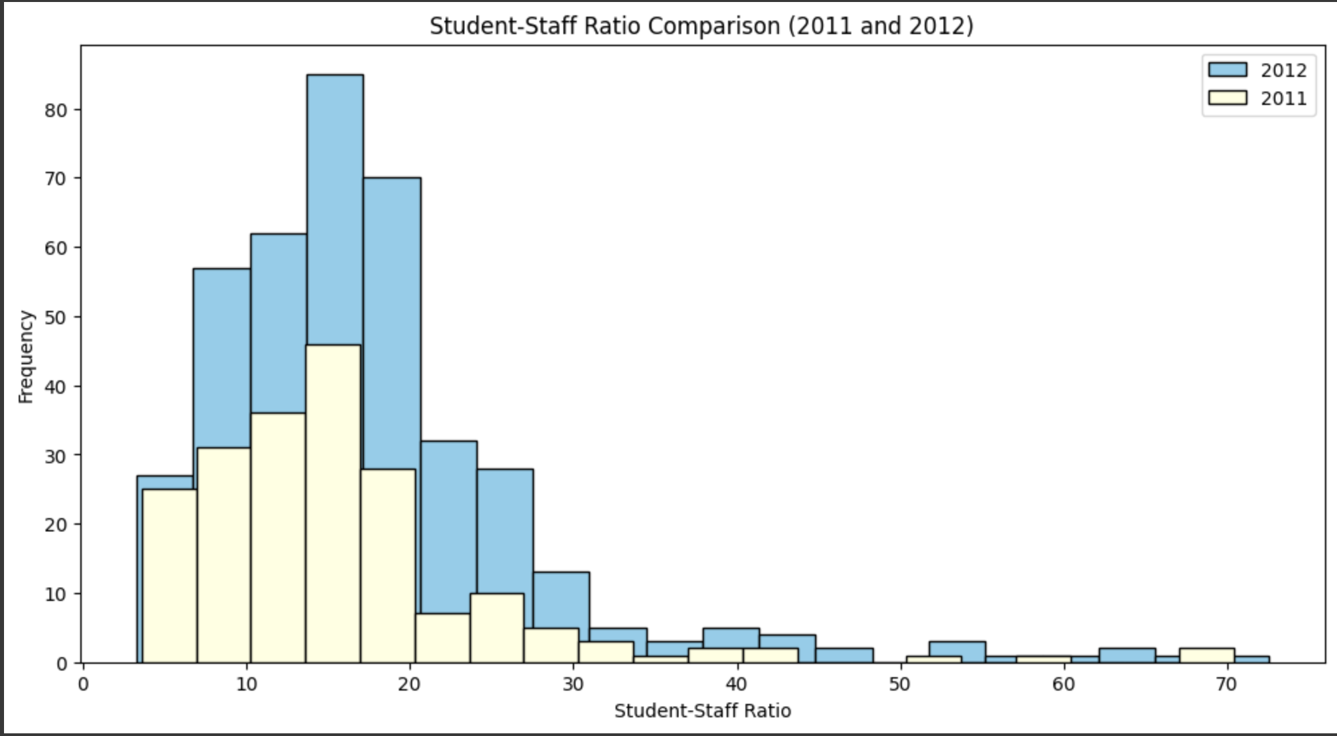
Here’s how to do it… let’s practice!
Exercise:
Overlapped Histogram
Stacked Histogram
https://colab.research.google.com/drive/1LEFtJ2Hi5Jb5U6JaZpteGFM5PZbsb0kA?authuser=0#scrollTo=1cYSmaCeDq_x
Notes:
Histogram exercise: https://colab.research.google.com/drive/1LEFtJ2Hi5Jb5U6JaZpteGFM5PZbsb0kA?authuser=0#scrollTo=1cYSmaCeDq_x

Slide 12
Questions?
with Sushmitha and Olena
Next up: Bar Charts
5 mins Theory
5 mins Exercise

Slide 13
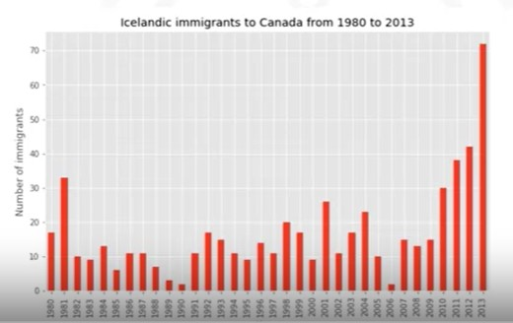
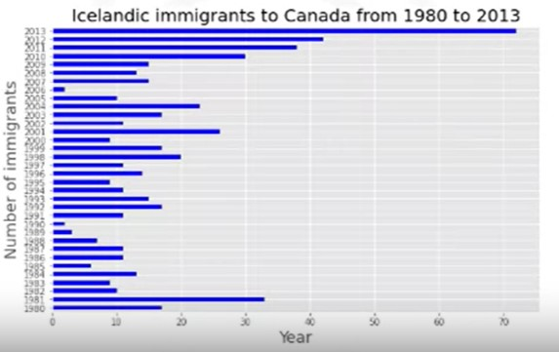
Bar Charts
5 mins
Here’s what you need to know:
1. Also known as Bar Graph
2. It compares the values of a variable
3. In plot(),
kind = bar, creates a vertical bar plot
Kind = barh, creates a horizontal bar plot

Slide 14

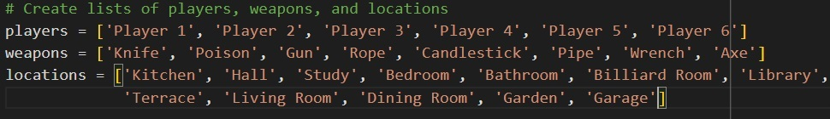
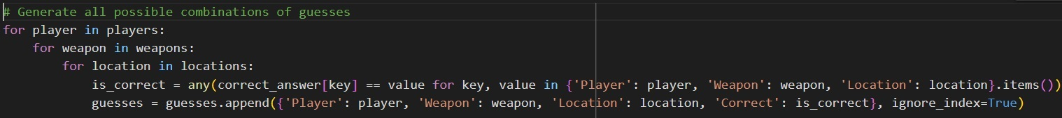
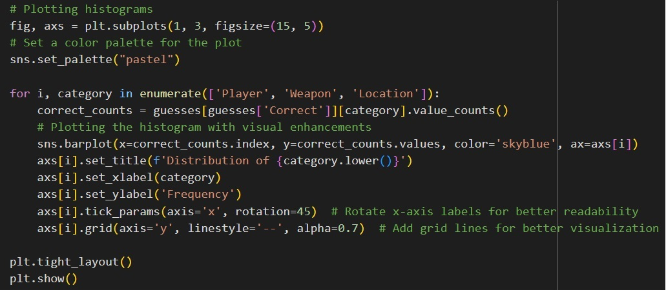
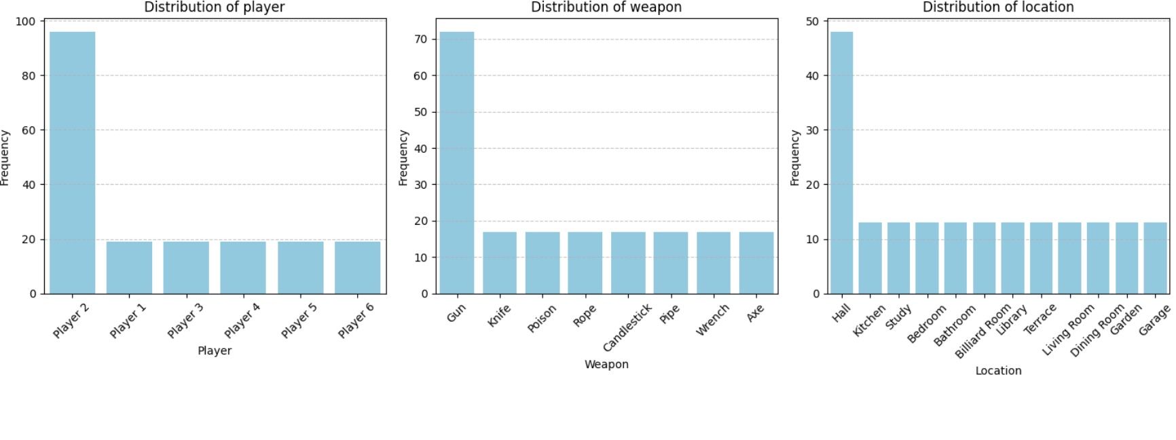
5 mins
How can bar charts help to analyse data using the example of the game Cluedo?
Exercise:
Cluedo is a murder mystery board game where players must deduce who committed the murder, with what weapon, and in which room.
In our example there are 6 players, 8 possible weapons and 12 rooms.
To begin with, I will make a table of all possible versions of the evidence in such a way that if at least one of the evidence is correct, then the answer will be “possibly” or “true”.
You can find out the answer to the riddle if you create three bar charts correctly.
Link to Colab file
Notes:
https://colab.research.google.com/drive/1oMJxEEsg8pdLD_lqmhJcycjQfCS7ja__?usp=sharing

Slide 15
Questions?
Next up:
Game Time

Slide 16
Let’s play
Jeopardy!

Slide 17
Link to the game:
https://jeopardylabs.com/play/nov14_g2-basic-matplotlib-visualization-tools

